Slide 1
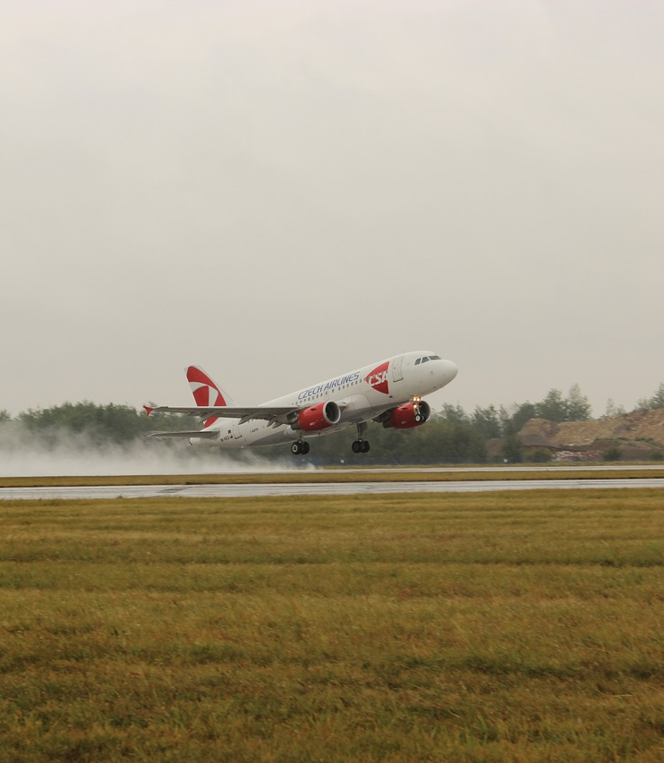
Avionics Safety Report
WHITLEE PEARSON
JAY IRAJ
RIGAT ASHEBIR

Slide 2
Outline
Problem Statement
Values
Data Understanding
Result
Conclusion

Slide 3
Problem Statement
Our team was asked to provide recommendations based on avionics safety data so that our company can establish a profitable and safe avionics department

Slide 4
After establishing an avionics department, our company will be responsible for lives or goods (depending) and therefore this research will help our company fiscally later.
values

Slide 5
Data Understanding
Injury severity rating
Minor | 1
Serious | 2
Fatal | 3
Location based analysis

Slide 6
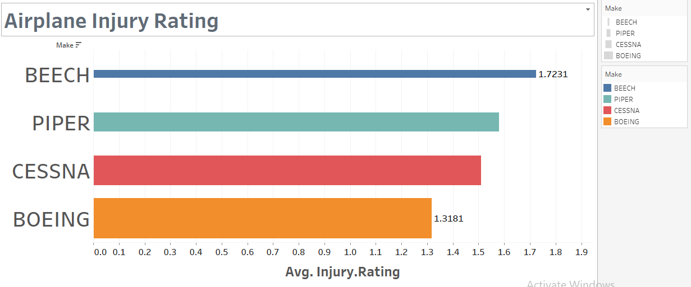
Result

Slide 7
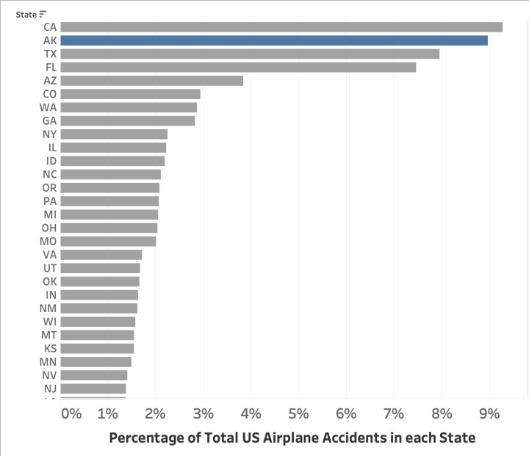
Result

Slide 8

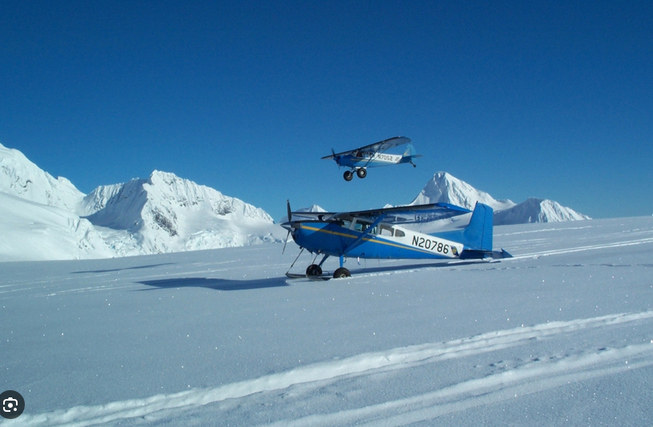
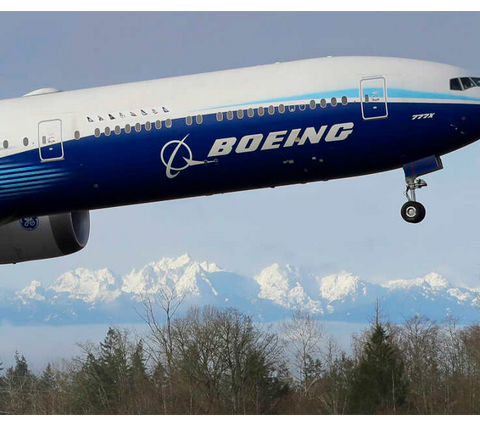
Conclusion
Beech has the least favorable safety record
we recommend avoiding operations in that state of Alaska where possible.
Boeing stands out as the most robust safety record

Slide 9

Thank you

